Slide 1
It’s Alive!
Evolving Assemblers Using
Disassembler Oracles
May 18th, 2018 Andrew Lamoureux
Notes:
1) INTRODUCTION, HERE’S THE TITLE, “EVOLVING”, WE’LL GET TO THAT
2) INTENDED TO BE FUN
- No trendy languages. Python to prototype, C++ for speed. - Not too hard, no PHD needed. I tend to get “lost” midway thru most talks, this attempts to be 100% followable - No supercomputer needed. Early 2015 Retina MacBook Pro. 2.9 GHz Intel Core i5, one core. 3) MOTIVATION In our Binary Ninja product, we want users to be able to patch, inline edit, assemble single lines, assemble multiple lines as they work, and a few shortcomings in this department necessitated this work.

Slide 2
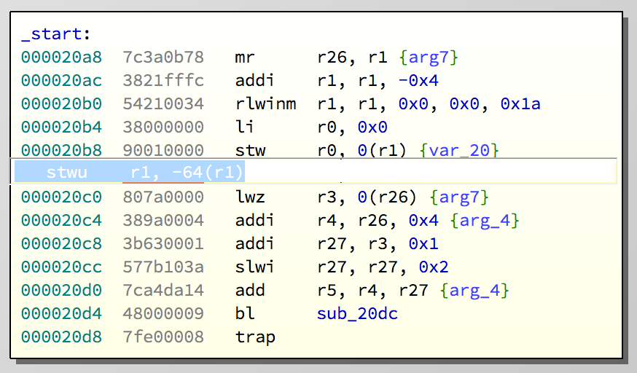
Motivation: Binary Ninja Development
“Round Tripping”
ENCODING
9421FFC0
DISASSEMBLY
stw r0, 0(r1)
Notes:
One of our shortcomings was, and admittedly still is, lack of round-tripping. It’s difficult when there are different authors for the assembler and disassembler. With LLVM we were asking users to type into the assembler dialogues something different than they saw in the disassembly view, not a good user experience! Do we adjust the assembler to match the disassembler? Or the other way around? Do we put in some type of translation layer? Mention the “e-enter test”.

Slide 3
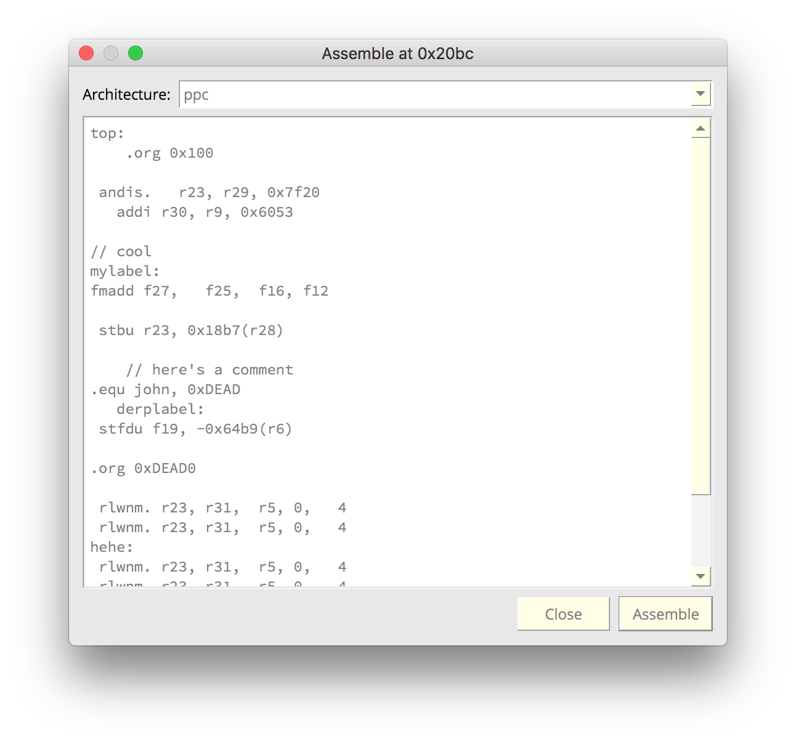
Motivation: Binary Ninja Development
Proper .org Support
Notes:
The .org directive is short for ORIGIN, it tells the assembler the location is of code we’re about to write, which is important because some instructions are location sensitive. For example if the user is at address 0 and assembles a “jump 50”, then a positive displacement is encoded. But if he’s at address 100, a negative displacement is entered.

Slide 4
Traditional Assembler
ASSEMBLER
ASSEMBLE “ADD”
case PUSH: … case POP: … case ADD: … case SUB: …
\xWHATEVER
Minor tasks: parse directives, db statements, labels, obj files – major task: instruction encoding – what if it’s YOUR JOB?
Notes:
Minor tasks: parse directives, db statements, keep track of labels, generate object files
Major tasks: encoding instructions
IF IT WAS YOUR JOB: 2 weeks, 80 hours between your editor and a specification PDF … BORING!

Slide 5
Oracle-Based Assembler (OBA)
ASSEMBLER
ASSEMBLE “ADD”
???
\xWHATEVER
DISASSEMBLER
Born from laziness, trying to avoid the 2week sentence of PDF reading
Notes:
But writing an assembler in this way, I claim, could in worst case be more interesting, and in best case actually faster. WOOHOO! Does your brain work at 40% efficiency when it’s a task you’re DREADING? Mine does :P

Slide 6
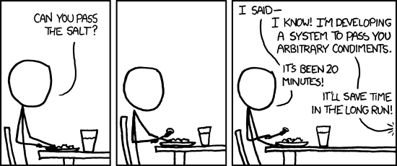
OBA Questions
Is time actually saved?
https://xkcd.com/974/
2. Does the approach fulfill Binary Ninja’s needs?
Notes:
Today’s Assembler will use a disassembler to assemble. We’re going to call it an oracle because we’ll be querying it for reliable advice many times.
It’s kind of cheap to include an XKCD comic to get nerd points, I admit, but this one titled “The General Problem” is very applicable here. Basically, instead of solving the problem at hand, which would take no time at all, the larger, more general problem is needlessly attacked, taking tons of time. So it’s natural to ask: will this round-about way really save more time? Or is it just entertainment? Does it work? Does it solve the round tripping and the origin problem? And even if it does, is the solution practical? Will users notice a slowdown? Will they be comfortable with a non-deterministic algorithm assembling for them?

Slide 7
Lookup Table (LUT) View
All Possible Encodings DEADBEEF
All Possible Strings “ADD”
DISASSEMBLING
ASSEMBLING
disassemble(): uint32_t -> string assemble(): string -> uint32_t
Started thinking in terms of a table – a disassembler compresses this table – gut feeling of inversion – cryptography says
Notes:
Let’s temporarily view assembling and disassembling as a giant lookup table. Disassembling, or number to string, appears to be easier, based on the AVAILABILITY of disassemblers and the SCARCITY of assemblers. Disassemblers don’t store the contents of this large table, they compute the values on the fly. Or, you could imagine that they DO store the entire contents of the table, but have “compressed” that table down into a program that can generate the contents of the table. Essentially you’re “unzipping” the table every time you ask it to compute. So I had a feeling you could invert this. That is: given a program that goes left-to-right, make something that goes right to left. Hopefully you’re about to call me out here: there are non-invertible processes in physics, and non-invertible functions in our field: if we take a block cipher and fix a key, we could consider the mappings of plaintext to ciphertext pairs as a giant LUT, and this of course is not feasibly invertible. But this isn’t physics, and nobody has sat down and intentionally made this LUT difficult to invert, so I wondered how hard it could be.

Slide 8
Lookup Table (LUT) View
. . . 7898A349 7898A34A 7898A34B 7898A34C 7898A34D 7898A34E 7898A34F 7898A350 7898A351 7898A352 7898A353 7898A354 7898A355 . . .
. . . srai.d $w13, $w20, 0x18 sat_u.d $w13, $w20, 0x18
undef
undef
sra.b $w13, $w20, $w24
subv.b $w13, $w20, $w24
undef
adds_a.b $w13, $w20, $w24
subs_u.b $w13, $w20, $w24
maddv.b $w13, $w20, $w24
undef
splat.b $w13, $w20[$t8]
srar.b $w13, $w20, $w24
. . .
DISASSEMBLING
ASSEMBLING
If we could see the entire table at one time, problem is solved – but instead we have a “flashlight”
Notes:
I can never see the entire table at once. It’s as if I’m in dark warehouse with no lights, and 4.3 billion square feet. But as I wander around, I have a flashlight with me. If the lights in this warehouse were turned on so that we could see all the encoding <-> string pairs, then we would be done. We could, for instance, simply sort the strings, and when the user types something in, search for it, and return its encoding pair. What prevents this? Sheer size, storage.

Slide 9
Spoiler: Guess and Check
ASSEMBLE AN “ADD”
Guess
Check
Modify
GUESS
0xDEADBEEF
DISASSEMBLER
“SUB”
no
MATCH?
yes
Notes:
Since we can’t turn on all the lights, since we can’t view all the table at once, we settle (at this time) on a guess, check, and modify approach.

Slide 10
Oracle-Based Assembler
ASSEMBLER
ASSEMBLE “ADD”
\xWHATEVER
GUESS
DISASSEMBLER
no
MATCH?
yes
If we substitute the “Guess, Check, Modify” into the diagram with Homer in it, here’s what we get…
Notes:
Substituted back into our earlier diagram, Homer is happy.

Slide 11
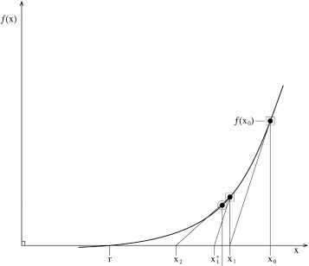
Guess’n’Check In Different Fields
no matter, just need actionable feedback
“Guess’n’Check” doesn’t sound very elegant, but it’s found in tons of different fields
Notes:
Guess’N’Check does not seem elegant. But it’s common with fancier language in different fields. In analysis: Newton Raphson method. In nature: the guesses at what the optimum animal is are the offspring with small genetic variations from their parents. The check is whether that offspring survives until reproductive age. And the modification and feedback is implicit because only survivors get to repeat the cycle. And if you’re a child that has no idea what I’m talking about, imagine a simple game of hot and cold where I’ve hidden a delicious ice cream cone and as you move about trying to find it, I give you verbal cues “hot” when you’re close, and “cold” when you’re far. And by shuffling about, you eventually find the treat. The point is, there’s no wrong way to think about it, and although we’ll adopt the fancy terminology of genetic algorithms, because it’s kind of closer to computer programming, no specialized knowledge is necessary. In other words, if you can play the hot and cold game, you can understand the material ahead.

Slide 12
Problems with Vanilla Genetic Algorithm
Where to start?
What fitness function?
How to converge?
The remainder of this talk solves these problems.
The “isolated opcode problem”
Notes:
Since our field is computers, we’ll adopt the terminology from genetic algorithms. The offspring are the guesses, and our fitness function will score how close our guess is to the requested assembler.
Done! Case closed. Just use genetic algorithm to make an assembler, why didn’t I think of that earlier? Not so fast… We have these three issues still, and we’ll spend the rest of the talk resolving them. 1) Where to start? Think of isolated opcodes like “nop” that have a single encoding. How would you find it in a sea of 4.3billion opcodes?

Slide 13
Instruction Space as Number Line
7898A349 srai.d $w13, $w20, 0x18
7898A34A sat_u.d $w13, $w20, 0x18
7898A34B undef
7898A34C undef
7898A34D sra.b $w13, $w20, $w24
7898A34E subv.b $w13, $w20, $w24
7898A34F undef
7898A350 adds_a.b $w13, $w20, $w24
7898A351 subs_u.b $w13, $w20, $w24
7898A352 maddv.b $w13, $w20, $w24
7898A353 undef
7898A354 splat.b $w13, $w20[$t8]
7898A355 srar.b $w13, $w20, $w24
…but this is a very human view
also try 0x11223344
Notes:
The most natural way to arrange the instructions is on a number line. But it’s a very human view because we’ve assumed that two values are “close” together if there is little difference in the quantities that these bits encode. But from the disassembly, we see that this does not group instructions together very well. For instructions that have a numeric operand on the right hand side (eg: addis), this does work very well. See the range [0x11223344, …] As a 2d number line? As a 2d number line with Hilbert space-filling curve. With gray code?

Slide 14
Choosing a Disassembler
Capstone
Engine!
from capstone import * md = Cs(CS_ARCH_PPC, 0) for I in md.disasm(“\xDE\xAD\xBe\xEF”, 0): print i.mnemonic + ‘ ‘ + i.op_str
Notes:
Where do these instructions come from btw? We’re using capstone. Why capstone? Free, under BSD License Multiple architectures Easy to install (brew, pip, apt-get) Easy to use! But no, not perfect!

Slide 15
Pros/Cons Capstone
Pros
Free: BSD License
Multiple Architectures
Easy to Install (brew, pip, apt-get)
Widespread Adoption
Cons
Not performance oriented
The cs_detail isn’t always accurate
Some bugs
Notes:
Pros and Cons

Slide 16
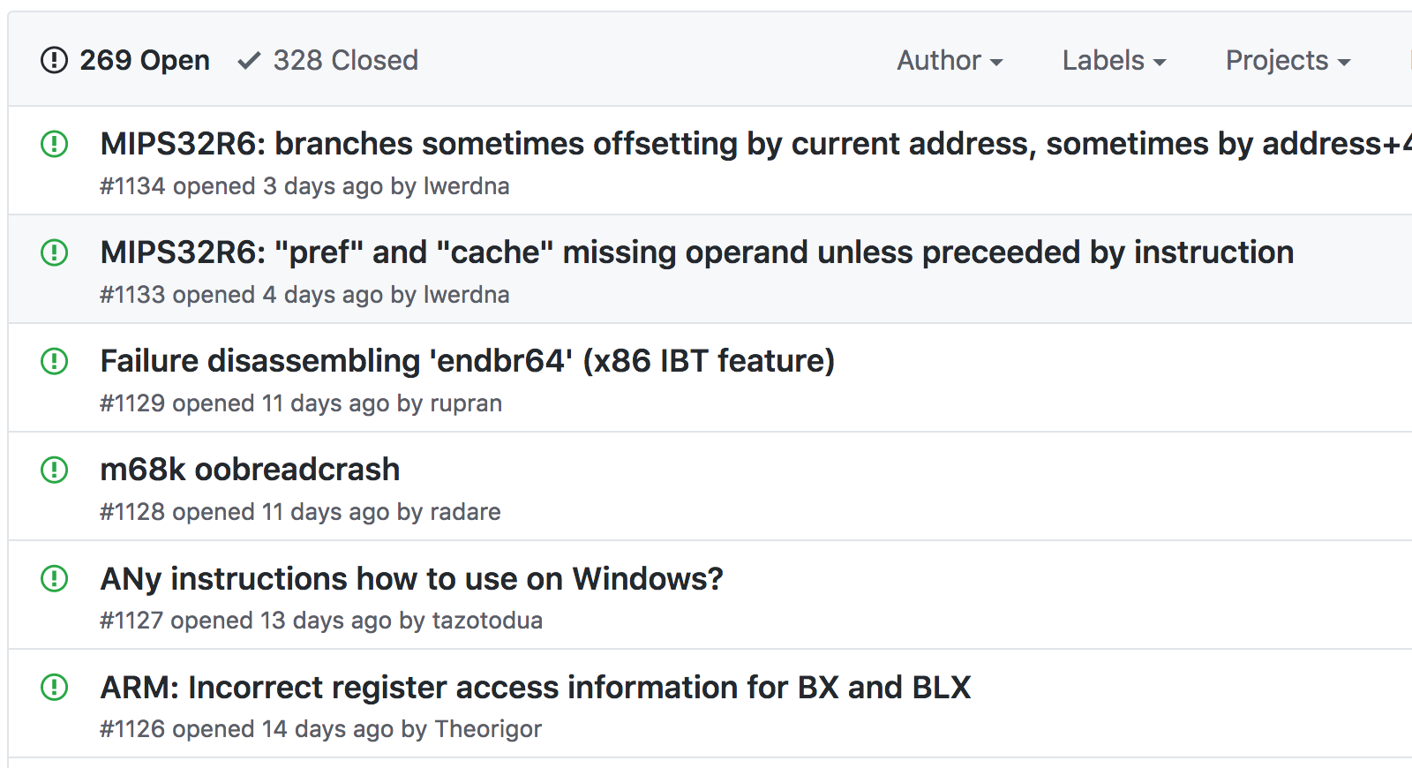
Capstone Ain’t Perfect
Notes:
Good or bad, depending on how you look at it. Nearly 300 bugs, but over 300 bugs closed. Actively used and report it. I think this bug state is positive.

Slide 17
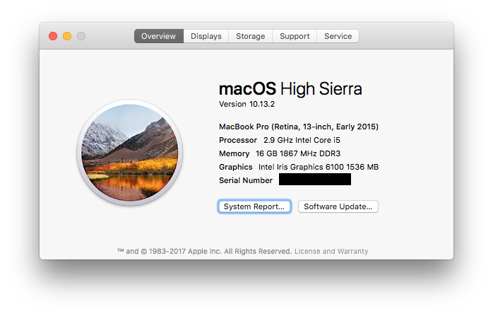
Capstone Speed
How long to go thru instruction space? About 40 minutes
[Timing Tests]
Notes:
Here are some speed tests. Note that cs_disasm() allocates memory.
While we’ve decided on capstone, this methd is generalized and ANY disassembler would work.

Slide 18
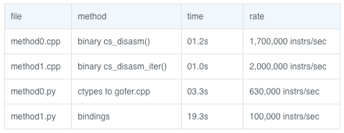
Capstone Speed
How long to go thru instruction space? About 40 minutes
[Timing Tests]
Notes:
Also note that benchmarking is a bit tough, at least for me. There are various timing methods, some use wall-block time, some cpu-time, so take these with a bit of skepticism.

Slide 19
Exploring The Number Line
examples = {} count = {}
for insword in xrange(0,2**32):
opcode = disassemble(insword).split()[0]
if not opcode in examples:
examples[opcode] = insword count[opcode] = 1 else:
count[opcode] += 1
show survey_opcs.py, opc_counts.txt, opc_examples.txt
Notes:
Exploring the number line is pretty straight forward, we just loop from all values 0 to 4.3 billion. Along the way, we want to collect information: what is the first encoding for each opcode, something we’ll refer to as an example or a seed or starting values. Also we want to collect the amount of each opcode we encounter, that will give us an idea of how big the problem is that lies ahead. Show “: 1$” instructions. Show “: \d\d\d\d\d\d$” instructions. Show if you include the punctuation or not.

Slide 20
Problems with Vanilla Genetic Algorithm
Where to start?
What fitness function?
How to converge?
The remainder of this talk solves these problems.
Notes:
Just a lookup from opcode to seed value solves the “isolated opcode problem”. But we can improve….

Slide 21
Instruction Space as a TreeMap
mips treemap
ppc treemap
Notes:
Note that the treemap appears to show proximity, but it’s not real. The only input it has is the size of each opcode (the number of encodings).

Slide 22
Instruction Space as a Hypercube
01
11
1
00
10
0
001
011
000
010
001
011
000
010
https://en.wikipedia.org/wiki/Hypercube
Notes:
If an architecture had 1-bit instruction encoding, there would be two instructions. If 2-bit encoding, 4 instructions, and so on… For PPC and MIPS, we have 32-bit encoding, so 4.3 billion instructions.

Slide 23
Instruction Space as a Graph
https://en.wikipedia.org/wiki/Hypercube
Notes:
If we could send the hypercube off to a hydraulic press and squish it down into something flat, I think we’d get something like this. Remember, nodes are just instruction encodings, and edges exist between nodes if the two encodings differ by at most a bit, or have hamming distance 1. Weird little rules pop up, like no triangles allowed. We know there are 2^32 nodes, but I’m not sure how many edges. We know that the longest distance between any two nodes is just 32, thank of 000..0 and 111..1 OMG now there’s modern art on the screen.

Slide 24
Instruction Space as a Graph
0x23465C04: subfic r26, r6, 0x5C04
0x23465C02: subfic r26, r6, 0x5C01
0x23465C00: subfic r26, r6, 0x5C00
0x23465C08: subfic r26, r6, 0x5C08
0x23465C01: subfic r26, r6, 0x5C01
https://en.wikipedia.org/wiki/Hypercube
Notes:
Substituting actual instructions might make things more concret. In the middle here we have the “subfic” instruction, and the edges accurately depict 1-bit changes. We travel to various subficts with differing immediates encoded on the least significant side of the instruction.

Slide 25
Edges Omitted
Notes:
I’ll ask now that you allow me to draw the graph with the nodes packed in a dense grid like array and omit the edges. While we can keep the “real” graph with 32 edges per node in the back of our mind, let’s use this as a model, and assume every orthogonally adjacent neighbor shared an edge, that is, their encoding is 1-bit apart.

Slide 26
Opcode Regions, or “Islands”
subfic island
addis island
nop island
Notes:
Now we can region off certain nodes that share the same opcode. Notice that in the middle of the region, there’s a hole. This represents many encodings that will allow something like “general purpose register, except for SP”, or “all values here, except for 0”. Notice that NOP island has population 1.
This picture is NOT meant to imply that all opcodes have some hamming-distance-1 path from one another. There could be another subfic region outside of view, for instance.

Slide 27
Number Line vs. Hamming=1 Travel
sat
undef
sra
subv
srai
Notes:
For instructions that have a numeric operand on the least significant side of the instruction, this is a bit of an overexxageration. As we saw earlier when iterating over the number line, the “human way” can sometimes yield connected sets of instructions, but sometimes not.

Slide 28
Number Line vs. Hamming=1 Travel
sat
undef
sra
subv
srai
Notes:
If we could send the hypercube off to a hydraulic press and squish it down into something flat, I think we’d get something like this. Remember, nodes are just instruction encodings, and edges exist between nodes if the two encodings differ by at most a bit, or have hamming distance 1. Weird little rules pop up, like no triangles allowed. We know there are 2^32 nodes, but I’m not sure how many edges

Slide 29
Number Line vs. Hamming=1 Travel
sat
sra
subv
srai
Notes:
Here’s a larger picture with a desired path of travel. We want it so that when

Slide 30
Islands Are The Guesser’s Starting Points
GUESS
. . . case SUBV: case SAT: case SRAI: case SRA: . . .
DISASSEMBLER
PPC: ~1000 opcodes ~75% defined ~3 million instrs/island
no
MATCH?
yes
Notes:
Now we have a picture to go with OBD’s initial guess.

Slide 31
Worst Case: Separated Distant Regions
Notes:
One instruction, two islands, separated by a bit distance greater than 1.

Slide 32
More Regions Are Better
PPC: stmw
stmw <gpr>, <num> (num)
stmw <gpr>, <num> (GPR)
Notes:
Multiple islands for ONE opcode is bad. Multiple islands for multiple opcodes is good. We purposely increase the number of islands by splitting opcodes based on the syntax. Here, stmw is dintinguished based on whether it takes GPR, NUM, (NUM) or GPR, NUM, (GPR).

Slide 33
More Islands Via Tokenization
0xBC000000
disassembler
S
T
M
W
r
0
,
0
(
0
)
tokenizer
STMW
gpr
,
num
(
num
)
Notes:
We do simple string tokenization to categories the opcodes into their syntaxes.

Slide 34
More Islands Via Tokenization
0xBC010000
disassembler
S
T
M
W
r
0
,
0
(
r
1
)
tokenizer
STMW
gpr
,
num
(
gpr
)
Notes:
Easy.

Slide 35
What Possible Tokens?
PPC:
MIPS:
GPR VREG FLAG CREG VSREG FREG NUM list(‘(),.+-’)
FREG WREG ACREG GPREG NUM CASH OFFS list(‘[](),.*+-’)
show mips/common.py
Notes:
Was intimate knowledge of the instruction sets required to know what tokens were coming? Nope, I just started by picking off the first word and calling that the opcode, eating whitespace, and seeing what happens. When something wasn’t recognized, I’d look for patterns. For example, if I saw “F0” and “F9” and “F2” I’d just make something up like “FREG” and match on “F\d+”.

Slide 36
How do we find syntax examples?
for insword in examples: for ss in EverySubsetOf4Bits(): for val in range(16):
insword2 = apply(insword, ss, val)
tokens = tokenize(disassemble(insword2))) syntax = ‘ ‘.join(tokens) if not syntax in seen: seen[syntax] = insword2
nCr(32,4) * 16 = 575,360
nCr(32,5) * 32 = 6,444,032
syn_examples.txt
Notes:
Looping thru the entire instruction set and tokenizing all strings is a possibility, but takes over 24 hours on my computer. So instead, we fuzz all the opcode seeds we have.

Slide 37
How do we find syntax examples?
0x40000000: bdnzf
FUZZER
TOKENIZER
IS OPCODE THE SAME?
NO
YES
40000000: bdnzf FLAG
40000004: bdnzf FLAG , NUM
40040000: bdnzf NUM * CREG + FLAG
40040004: bdnzf NUM * CREG + FLAG , NUM
Notes:
Here’s the fuzzing operation in picture form.

Slide 38
Toggling 4-bits At a Time
2098 Island Now 1.5 million instrs/island
Notes:
Here’s a conceptualization of what a 4-bit change looks like on our graph.

Slide 39
Guesser Deals In Syntaxes Now
GUESS
. . . case “andc GPR , GPR , GPR”: case “andc . GPR , GPR , GPR”: case “andi . GPR , GPR , NUM”: case “andis . GPR , GPR , NUM”: case “bdnz NUM”: case “bdnz”: case “bdnz – NUM”: case “bdnz –”: case “bdnz + NUM”: . . .
DISASSEMBLER
PPC: 2098 syntaxes ~75% defined 1.5 million instrs/island
no
MATCH?
yes
Notes:
Now OBD’s initial guess is improved to go to more targeted regions. Before, there was a region or island per opcode. Now, there’s a region or island per syntax.

Slide 40
Recap
Didn’t know where to initiate guesses
Scanned instruction space to find examples for each opcode (this solved the “Where to start?” problem)
Too broad, split opcodes into their syntaxes

Slide 41
Problems with Vanilla Genetic Algorithm
Where to start?
What fitness function?
How to converge?
The remainder of this talk solves these problems.
Notes:
Next: the fitness function.

Slide 42
Comparing Assembly, Fitness Function
swc1 $f23, -0x7a46($t9)
Which one is closest?
swc1 $f0, 0x101($zero)
sdc1 $f23, 0x7a46($t9)
swc1 $f0, 0x106($zero)
swc1 $f15, -0x7a46($zero)
swc1 $f23, -0x7a46($at)
swc1 $f23, -0x7a46($t1)
https://en.wikipedia.org/wiki/Category:String_similarity_measures
Notes:
How do we tell how close two disassemblies are? What metric do we use? String similarity? Levenshtein distance?

Slide 43
Comparing Assembly, Fitness Function
swc1 $f23, -0x7a46($t9)
tokenizer
OPC “swc1”
FREG 0x17
,
NUM 0xFFFF85BA
(
GPR 0x19
)
Which one is closest?
OPC “swc1”
FREG 0x00
,
NUM 0x101
(
GPR 0x0
)
OPC “sdc1”
FREG 0x17
,
NUM 0xFFFF85BA
(
GPR 0x19
)
OPC “swc1”
FREG 0x00
,
NUM 0x106
(
GPR 0x00
)
OPC “swc1”
FREG 0x15
,
NUM 0xFFFF85BA
(
GPR 0x00
)
Notes:
With tokenization, maybe it is easier?

Slide 44
Comparing Assembly, Fitness Function
Score zero if:
Opcode mismatch
Token quantity mismatch
Token type mismatch
For STRING tokens:
0% if mismatch, 100% otherwise
For NUM tokens, registers:
hamming distance
For OFFS tokens:
hamming distance of encoded address
Notes:
I tried to reflect while thinking about the example. I throw away two disassemblers if they don’t share same opcode (even if they share the same operands). Numeric types should use hamming distance, etc.

Slide 45
Comparing Assembly, Fitness Function
quantity/type check
hamming()
OPC “swc1”
FREG 0x17
,
NUM 0xFFFF85BA
(
GPR 0x19
)
OPC “swc1”
FREG 0x15
,
NUM 0xFFFF85BA
(
GPR 0x00
)
require !strcmp()
strcmp()
Assemble.cpp PPC
Assemble.cpp MIPS
Notes:
Just picture represenation of how two syntaxes are compared after being tokenized.

Slide 46
Problems with Vanilla Genetic Algorithm
Where to start?
What fitness function?
How to converge?
The remainder of this talk solves these problems.
Notes:
Next!

Slide 47
After failure, what direction?
What do we do on guess #2? …on guess #3? …on guess #4? Randomly toggle bits?
GUESS
. . . case “andc GPR , GPR , GPR”: case “andc . GPR , GPR , GPR”: case “andi . GPR , GPR , NUM”: case “andis . GPR , GPR , NUM”: case “bdnz NUM”: case “bdnz”: case “bdnz – NUM”: case “bdnz –”: case “bdnz + NUM”: . . .
DISASSEMBLER
no
MATCH?
yes

Slide 48
Fuzzing Encodings
Precompute which bits are worth toggling
# given opc with encoding insword always1 = insword
always0 = ~insword
for ss in EverySubsetOf4Bits():
for val in range(16):
insword2 = apply(insword, ss, val)
# continue if different syntax
always1 &= insword2 always0 &= ~insword2
mips_sandbox/syn_bitpatterns.py ppc_sandbox/syn_bitpatterns.py
Notes:
Again, fuzz. We can keep track of which bits are constant for all encodings that have a certain syntax.

Slide 49
In search of bit patterns…
7C000215: 'add . GPR , GPR , GPR'
FUZZER
TOKENIZER
IS SAME SYNTAX?
YES
NO
. . . 7C000215: 1111100000000000000001000010101
7C200215: 1111100001000000000001000010101
7C000215: 1111100000000000000001000010101
7C200215: 1111100001000000000001000010101
7C000215: 1111100000000000000001000010101
7C800215: 1111100100000000000001000010101
7C400215: 1111100010000000000001000010101
7CC00215: 1111100110000000000001000010101
7C000215: 1111100000000000000001000010101 . . .
Notes:
We have a seed or an example for every format.
We feed that seed into the fuzzer, which does the 4-bit wide changes. All those outputs go to the tokenizer, which sees if it has the same syntax. If not, the results are tossed, but if yes, we track all the bits….

Slide 50
In search of bit patterns…
. . . 7C000215: 01111100000000000000001000010101
7C200215: 01111100001000000000001000010101
7C000215: 01111100000000000000001000010101
7C200215: 01111100001000000000001000010101
7C000215: 01111100000000000000001000010101
7C800215: 01111100100000000000001000010101
7C400215: 01111100010000000000001000010101
7CC00215: 01111100110000000000001000010101
7C000215: 01111100000000000000001000010101 . . .
0’s rememberer, 1’s rememberer
ALWAYS1: 7C000215 01111100000000000000001000010101 ALWAYS0: 800001EA 10000000000000000000000111101010
HELPER: 011111xxxxxxxxxxxxxxx01000010101
SYNTAX: 'add . GPR , GPR , GPR‘
SEED: 0x7C000215 CMASK: 0x03FFF800
“ADD . GPR , GPR , GPR”
011111xxxxxxxxxxxxxxx01000010101
Notes:
Another dense slide, but check it out. Column-wise, you’ll see that all encodings that stayed in this syntax region have certain bits that hold as 1 or as 0, we track them. By the time we’re done, we’ve kind of archived that all add’s of this syntax have this seed, and this change mask. Ah forget all of that. Just know that once we track all the bits, we learn that add’s of this syntax look like this. (grey box)

Slide 51
BitPatterns Found!
"tdi NUM , GPR , NUM",{0x0800000A,0x03FFFFFF}}, //000010xxxxxxxxxxxxxxxxxxxxxxxxxx tdi 0, r0, 0xa
"tdlgti GPR , NUM",{0x08200000,0x001FFFFF}}, //00001000001xxxxxxxxxxxxxxxxxxxxx tdlgti r0, 0
"tdllti GPR , NUM",{0x08400000,0x001FFFFF}}, //00001000010xxxxxxxxxxxxxxxxxxxxx tdllti r0, 0
"tdeqi GPR , NUM",{0x08800000,0x001FFFFF}}, //00001000100xxxxxxxxxxxxxxxxxxxxx tdeqi r0, 0
"tdgti GPR , NUM",{0x09000000,0x001FFFFF}}, //00001001000xxxxxxxxxxxxxxxxxxxxx tdgti r0, 0
"tdlti GPR , NUM",{0x0A000000,0x001FFFFF}}, //00001010000xxxxxxxxxxxxxxxxxxxxx tdlti r0, 0
"tdnei GPR , NUM",{0x0B000000,0x001FFFFF}}, //00001011000xxxxxxxxxxxxxxxxxxxxx tdnei r0, 0
"tdui GPR , NUM",{0x0BE00000,0x001FFFFF}}, //00001011111xxxxxxxxxxxxxxxxxxxxx tdui r0, 0
"twi NUM , GPR , NUM",{0x0C000000,0x03FFFFFF}}, //000011xxxxxxxxxxxxxxxxxxxxxxxxxx twi 0, r0, 0
"twlgti GPR , NUM",{0x0C200000,0x001FFFFF}}, //00001100001xxxxxxxxxxxxxxxxxxxxx twlgti r0, 0
"twllti GPR , NUM",{0x0C400000,0x001FFFFF}}, //00001100010xxxxxxxxxxxxxxxxxxxxx twllti r0, 0
"tweqi GPR , NUM",{0x0C800000,0x001FFFFF}}, //00001100100xxxxxxxxxxxxxxxxxxxxx tweqi r0, 0
"twgti GPR , NUM",{0x0D000000,0x001FFFFF}}, //00001101000xxxxxxxxxxxxxxxxxxxxx twgti r0, 0
"twlti GPR , NUM",{0x0E000000,0x001FFFFF}}, //00001110000xxxxxxxxxxxxxxxxxxxxx twlti r0, 0
"twnei GPR , NUM",{0x0F000000,0x001FFFFF}}, //00001111000xxxxxxxxxxxxxxxxxxxxx twnei r0, 0
"twui GPR , NUM",{0x0FE00000,0x001FFFFF}}, //00001111111xxxxxxxxxxxxxxxxxxxxx twui r0, 0
. . .
Notes:
This table, although it’s very ugly and dense, really captures 99% of the technique. For every syntax, we have a starting point, a mask of bits that should be toggled during search, which can also be represented by this bit format.

Slide 52
Pitfall: Fuzzer Needs 4 Bits!
SYNTAX: 'bgezalc GPREG , NUM': 0x19080000
RS
RT
BITS: 00011001000010000000000000000000
bgezalc $t0, 0
BITS: 00011000000000000000000000000000
blez $zero, 4
BITS: 00011000100001000000000000000000
bgezalc $a0, 0
Notes:
We cannot vary only 3 bits, because examples like these show that it will never find other examples where b3 in RS and RT are not set. To find another RS and RT that match and they don’t both have their b3 set, we have to make 4 bit changes.

Slide 53
Pitfall: Fuzzer needs 4 Bits!
RS
RT
BITS: 00011001000010000000000000000000
bgezalc $t0, 0
000110x1xxxx1xxx0000000000000000
15 reachable from
The bitpattern
16 lost
souls
Notes:
Since our example/seed for bgezalc has RS=RT=8 and we need 4 bit changes to reach it, we’ll never get a pattern

Slide 54
Recap
Wanted to use genetic algorithm, but..
collected seeds by searching the entire instruction space
tokenizing diversified the starting points, allowing us to think in terms of instruction syntaxes
syntaxes yielded a good fitness function that takes into account field types
fuzzed for bitpatterns which store what bits are worth twiddling
WHAT NOW?
Notes:
Just read it.

Slide 55
Putting it all together
“add. r0, r0, r0”
"addic GPR , GPR , NUM",{0x30000000,0x03FFFFFF}},
"addic . GPR , GPR , NUM",{0x34000000,0x03FFFFFF}},
"li GPR , NUM",{0x38000000,0x03E0FFFF}},
"addi GPR , GPR , NUM",{0x38010000,0x03FFFFFF}},
"lis GPR , NUM",{0x3C000000,0x03E0FFFF}},
"addis GPR , GPR , NUM",{0x3C010000,0x03FFFFFF}},
"bdnzf FLAG",{0x40000000,0x00230000}},
"bdnzfl FLAG",{0x40000001,0x00230000}},
"bdnzfa FLAG",{0x40000002,0x00230000}},
"bdnzfla FLAG",{0x40000003,0x00230000}},
"bdnzf FLAG , NUM",{0x40000004,0x0023FFFC}}, …
tokenize
“add . GPR , GPR, GPR”
syntax lookup
syntax error
genetic algorithm
Notes:
If the user entered something illegal, this is really the best time to catch it because we can say it was a syntax problem. If we look up only one entry from the table, we can scan the token types from left to right and say “expected a REGISTER here”. If we look up multiple, we can say “expected REGISTER or NUMBER here.

Slide 56
Putting it all together
seed: 7C000215
randomize x’s
parent: 7C123215
1-bit changer
bitpattern: 011111xxxxxxxxxxxxxxx01000010101
children
fitness
any score 100?
SUCCESS
new record?
failure limit?
FAILURE
re-seed
Notes:
Look at this monster, let’s go thru and see that it’s not so bad. Seed comes in, we know the x’s, so we randomize them and set the parent. To generate children, we toggle one bit of each of the x’s, and evaluate their fitness in the fitness function. Recall that the fitness function is doing what? It’s disassembling the child (capstone), tokenizing the output, and using that token comparison stuff we talked about earlier, where if the token type is numeric, we apply hamming distance. If it’s string, we apply strcmp(), and so on. So long as we’re making improvements with the 1-bit changes, we loop back around, overtaking the parent, and starting the process over.
The failure limit is important. How do we know when we’ve failed, or if more searching could have found the answer? My initial thought was to put a timer, but then this would vary and be inconsistent depending on how fast the machine is that’s running the algorithm. Instead what I did is very practical: Let the algorithm run overnight on random instructions, remembering the worst performers. Multiply that number by 4 and make it the threshold of failure.

Slide 57
Putting it all together
seed: 7C000215
randomize x’s
parent: 7C123215
1-bit changer
011111xxxxxxxxxxxxxxx01000010101
children
fitness
any score 100?
goal
new record?
failure limit?
re-seed
Notes:
Notice that a 1-bit movement left can end up in a region that is NOT of the current syntax. This is fine, and the fitness function will filter it out.

Slide 58
Why is re-seeding needed?
seed: 7C000215
randomize x’s
parent: 7C123215
1-bit changer
011111xxxxxxxxxxxxxxx01000010101
children
fitness
any score 100?
goal
new record?
failure limit?
re-seed
Notes:
If some instruction syntax exists on separated regions, a 1-bit change is not sufficient to find certain goals. The first generated parent is isolated from the goal instruction, the 1-bit changer will wander this island, fenced in by water. The re-seeding does random bit changes to the xxx’s, providing a chance to “hop” to a different island.

Slide 59
Genetic Hazards: Inter-field Dependencies
case 0x7C000004: // INS
{
insword = 0x7C000004;
insword |= toks[3].ival << 21; // rs
insword |= toks[1].ival << 16; // rt
insword |= (toks[7].ival + toks[5].ival - 1) << 11; // msb insword |= toks[5].ival << 6; // lsb break;
}
Notes:
In the INS instruction, the relationship is complicated enough that we special case it and assemble by hand. I didn’t go through the spec finding problematic cases. I watched a long-running instance of the assembler being given random instructions, and waited for instructions that didn’t assemble or took a long time to converge.

Slide 60
Genetic Hazards: Math Encodings
EffectiveAddress = CurrentAddress + (offs + 1) << 4;
Offset address
0000 000100 (4)
0001 001000 (8)
0011 010000 (16)
0010 001100 (12)
0110 011100 (28)
0111 100100 (36)
0101 011000 (24)
0100 010100 (20)
Notes:
Instructions where there’s a mathematical relationship between the encoding and the assembler value often have avalanche-like bit relationships. Highlighted in red are two instances where a 1-bit change in the offset results in a 3 and 4 bit changes in the resulting address. This is bad for convergence. A multiply by a power of 2 (shift) is a case where the relationship is ok for ODB.

Slide 61
Genetic Hazards: Inter-field Dependencies
RS
RT
BITS: 000110xxxxxxxxxxxxxxxxxxxxxxxxxx
bgezalc $t0, 0
must match
and nonzero
PPC Special Cases:
Sldi srwi slwi crclr xxspltd xxswapd xvmovdp xvmovsp mr tdi twi
MIPS Special Cases:
ins ext bgezc bgezalc bltzalc bltz any bxx 16-bit
Notes:
The simplest inter-field dependency is two fields needing to match. In PPC this often makes for “extended mnemonics” where are special cases of more general mnemonics. For example crclr is when crxor has three 5-bit fields matching.

Slide 62
OBA Questions
Is time actually saved?
https://xkcd.com/974/
2. Does the approach fulfill Binary Ninja’s needs?
Notes:
Yes, time is actually saved to write this. I estimate this took me 30-40hrs and a full featured assembler would take me 80hrs. Yes it does fulfill Binja’s needs. It’s been in operation for over a month for PPC and seems to perform well.

Slide 63
Pros/Cons of this approach
Pros
easier, faster, and more interesting to write
deniability: “it’s the disassembler’s fault!”
provable for small instruction spaces
Cons
slower
less feedback on errors
more difficult to maintain
Notes:
The provability part, I kind of wish I didn’t put it there because it’s certainly possible that we could set up some test harness that tasked a traditional assembler with every possible string output. You’d probably have to do a little bit of string “smoothing” to ensure that the assembler and disassembler are speaking exactly the same language. But yes, the PPC assembler is proven to work by exhaustively going through, or brute forcing everything encoding and assembly/disassembly.

Slide 64
Generalize where this will work?
One Guess: The suitability of an architecture to this approach related to:
How many single instructions split into multiple islands
By how much distance are those islands separated?
Notes:
I think inter-field dependencies and jumps in the encodings create these split islands.

Slide 65
Works On What Architectures?
Another Guess: Suitability is inversely related to the “avalanche effect” present in the ISA’s encodings
What percentage of instructions improve with the 1-bit guesser?
With the 2-bit guesser?
Notes:
See the slide on BNE and how one bit changes in the text input equals several bit changes in the encoding, or visa versa.

Slide 66
What does the future hold?
tackle more difficult spaces: ARM, THUMB, Intel
unify the PPC and MIPS versions
pure python version, submit to Python Package Index (PyPI)
the full exhaustive test of all MIPS
Automate the entire task! Evolve an assembler that uses an evolutionary algorithm given a disassembler.
Notes:
So far PPC and MIPS, but I’m a bit intimidate by THUMB, because some instructions like stmfd have a bitmask for each register pushed. The number of tokens will grow, but will the syntax? Unify the PPC and MIPS versions: right now on PPC I don’t include any punctuation after the opcode as part of the opcode, but on MIPS I do. Also, in MIPS I have an OFFS token type because displacements were done with a +4 and can be negative and such.
Python tested as slow, but I may have included the python initialization time in the benchmark, when it would have been more fair.

Slide 67
The End!
Questions?
https://github.com/lwerdna/generate_assembler
Notes:
Thank you to Jailbreak for inviting me to speak. Tom McGuire (TMAC) was especially accommodating and forgive my tardiness on several occasions, thank you.

